Slide 1


AIR POLLUTION STUDY
Project 2 NO2
Kseniya Yerameichyk
Ekaterina Sergeeva
Alexander Shlyakhtin
Dzmitry Kurch

Slide 2
Meeting Agenda
Discussion topics for today
01
02
03
04
Exploratory Data Analysis
Hypothesis Testing
Multivariate contribution analysis
Conclusions

Slide 3

Exploratory data analysis

Slide 4
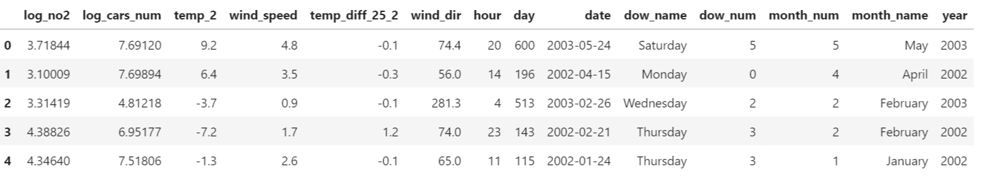
Data preprocessing
Dataset sample
Preprocessing steps
Renaming the columns
Creating a date column in yyyy-mm-dd format from October 1, 2001
Create additional columns for analyzing the time patterns like dow, month, year

Slide 5
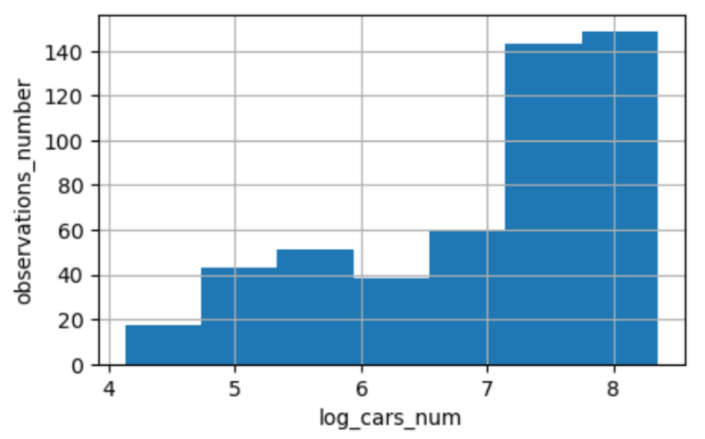
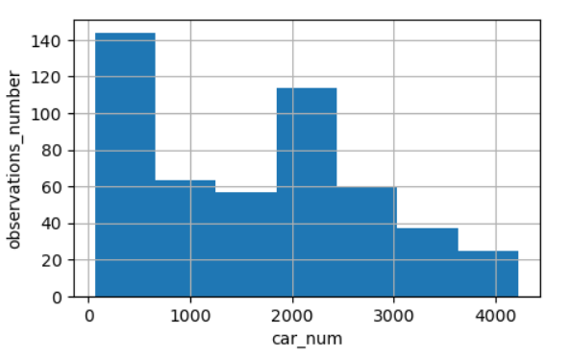
EDA
Cars distribution (ln)
Cars distribution

Slide 6
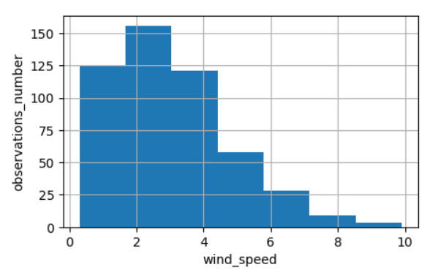
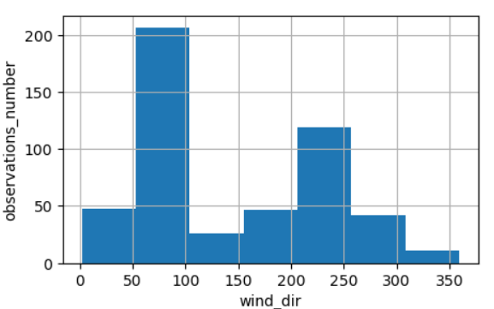
EDA
Wind speed distribution
Wind direction distribution

Slide 7
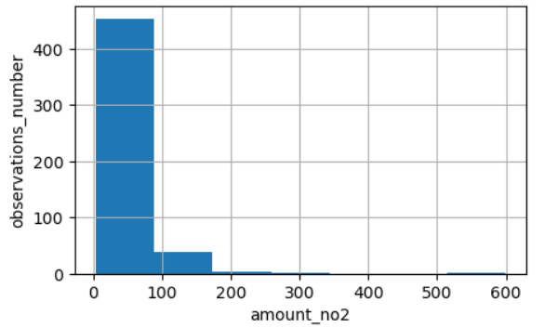
EDA
NO2 distribution

Slide 8
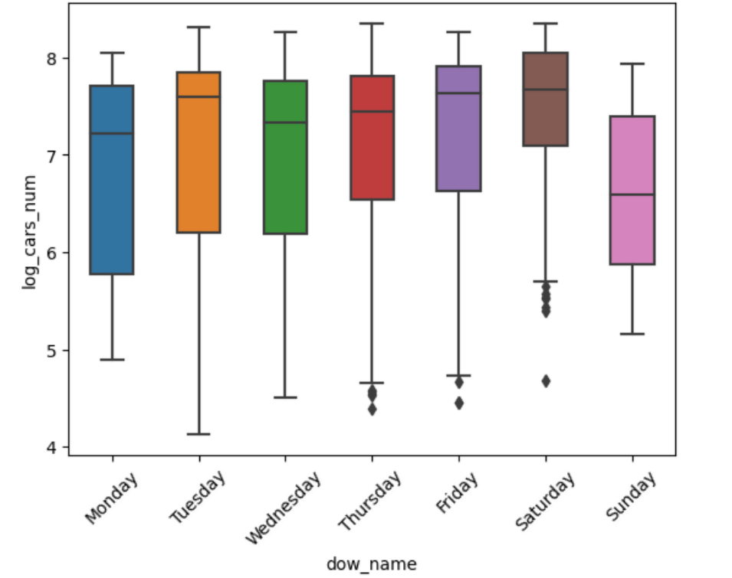
EDA
Cars number distribution by the day of week
Number of cars tend to grow during the week and drops down on Sunday.
Unexpected behavior on Tuesday

Slide 9
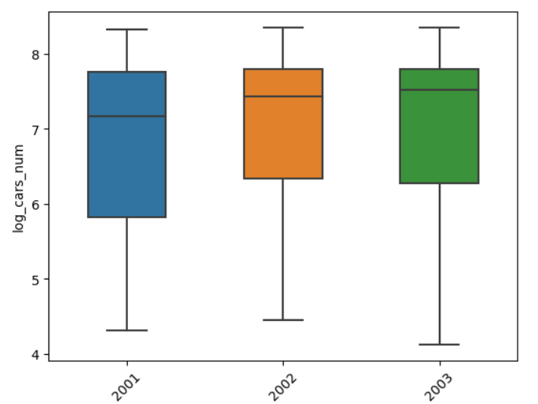
EDA
Cars number distribution each year
Number of cars have increased from 2001 to 2003

Slide 10
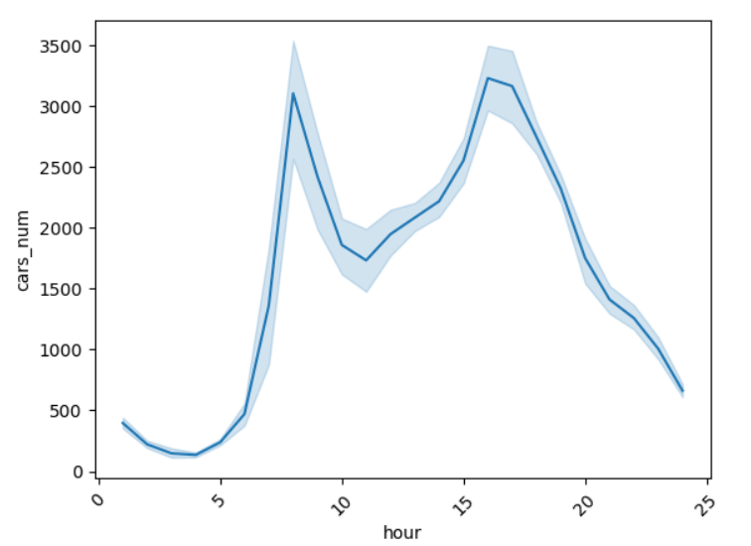
EDA
Cars number time series hourly aggregation
Number of cars "jumps" in the morning and in the evening

Slide 11
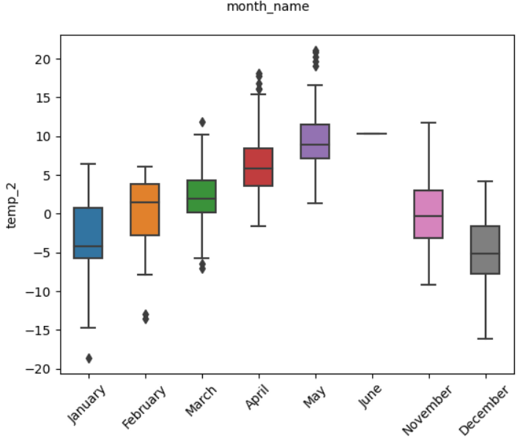
EDA
Temperature distribution across months
Temperature increases in summer and decreases in winter.
Missing data for June, July, August, September

Slide 12
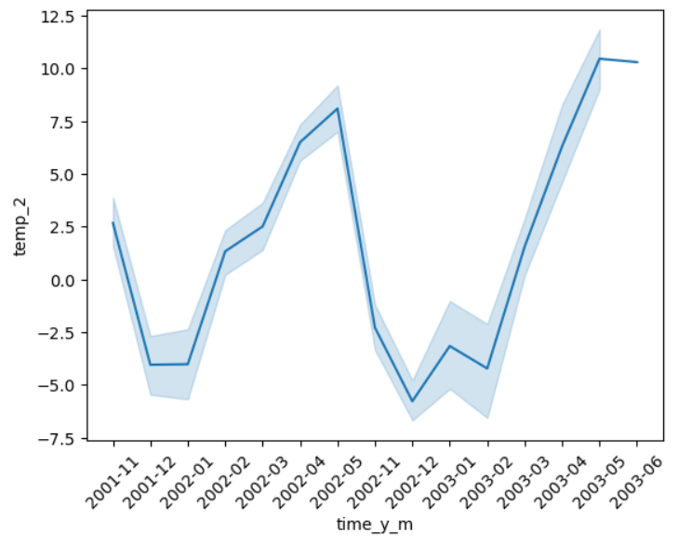
EDA
Temperature time series monthly aggregation
Temperature increases in summer and decreases in winter.
Missing data for June, July, August, September 2022

Slide 13
Hypothesis testing

Slide 14
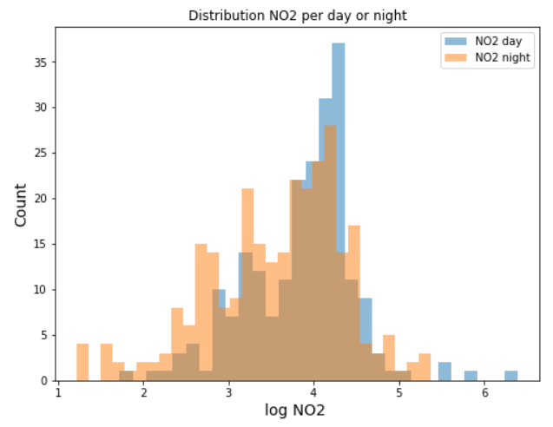
Hypothesis testing
1. NO2 concentration in the day* and night* hours
H0: day N02 = night N02
H1: day N02 != night N02
Test: Two-tailed T-test assuming equal variances
P-value: 0.000017
Conclusion: reject null hypothesis at alpha=0.01
*Day and night hours were checked in accordance with Norway time zone

Slide 15
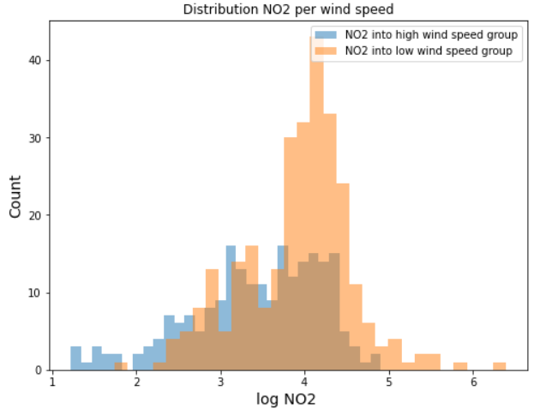
Hypothesis testing
2. NO2 concentration with high* and low* wind speed
H0: hws N02 = lws N02
H1: hws N02 != lws N02
Test: Two-tailed T-test assuming equal variances
P-value: 4.14 * 10^-13
Conclusion: reject null hypothesis at alpha=0.01
*High and low wind speed were defined in relation to the mean value

Slide 16
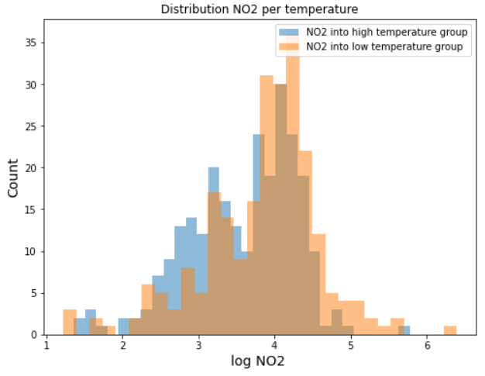
Hypothesis testing
2. NO2 concentration with high* and low* temperature
H0: ht N02 = lt N02
H1: ht N02 != lt N02
Test: Two-tailed T-test assuming equal variances
P-value: 0.000145
Conclusion: reject null hypothesis at alpha=0.01
*High and low temperature were defined in relation to the mean value

Slide 17
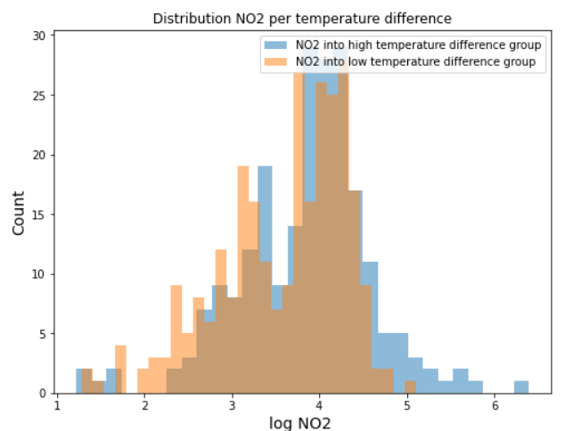
Hypothesis testing
2. NO2 concentration with high* and low* temp diff
H0: htd N02 = ltd N02
H1: htd N02 != ltd N02
Test: Two-tailed T-test assuming equal variances
P-value: 0.000159
Conclusion: reject null hypothesis at alpha=0.01
*High and low temperature difference were defined in relation to the mean value

Slide 18
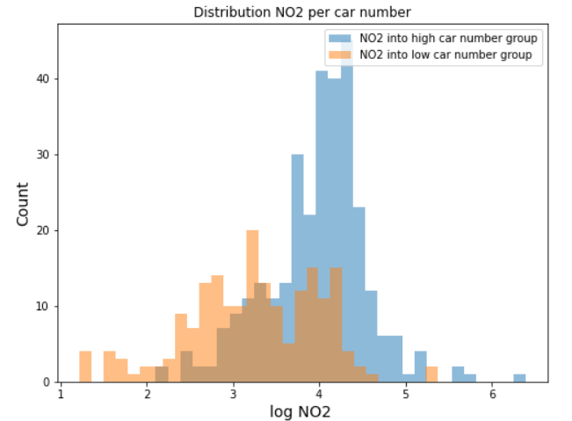
Hypothesis testing
3. NO2 concentration with high* and low* cars num
H0: hcn N02 = lcn N02
H1: hcn N02 != lcn N02
Test: Two-tailed T-test assuming equal variances
P-value: 0
Conclusion: reject null hypothesis at alpha=0.01
*High and low cars number were defined in relation to the mean value

Slide 19
Multivariate contribution analysis

Slide 20
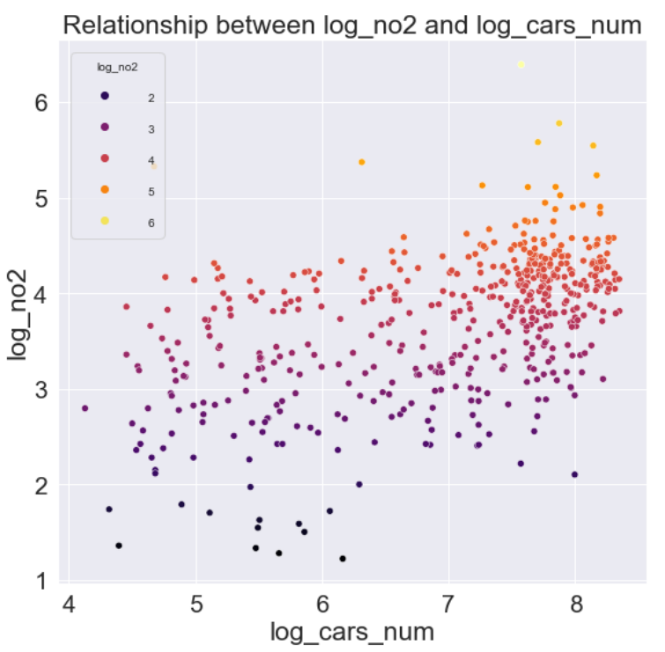
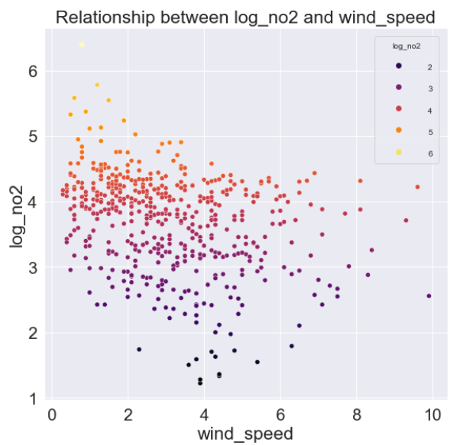
Multivariate analysis

Slide 21
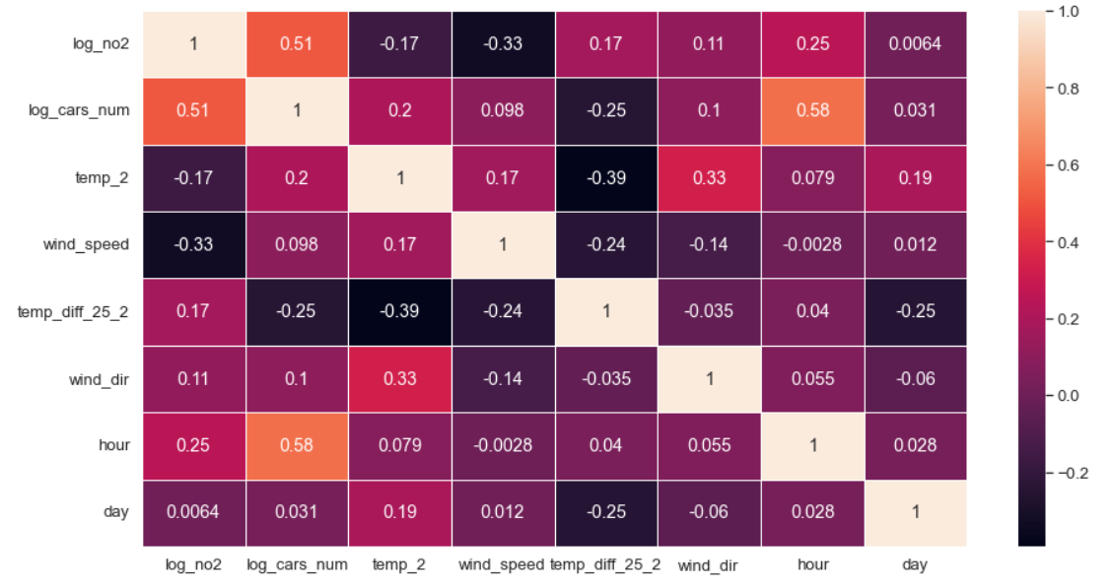
Multivariate analysis
Correlation matrix for input variables

Slide 22
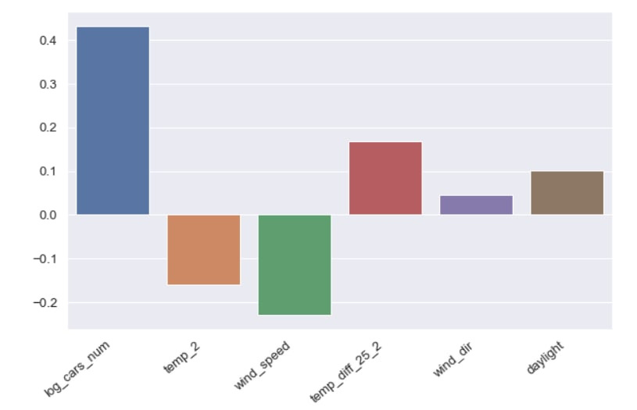
Multivariate analysis
Linear factor contribution
Combine features into object-factor matrix
Normalize features
Train Linear Regression model with regularization (elastic net)
Visualize weights of the linear model

Slide 23
Conclusions

Slide 24
Conclusions
The study was well-designed in terms of factors selection
Number of cars significantly contributes to the NO2 concentration
Temperature and wind speed affects NO2 concentration inversely
Day time patterns have an indirect relationship with NO2 concentration through number of cars

